Slide 1
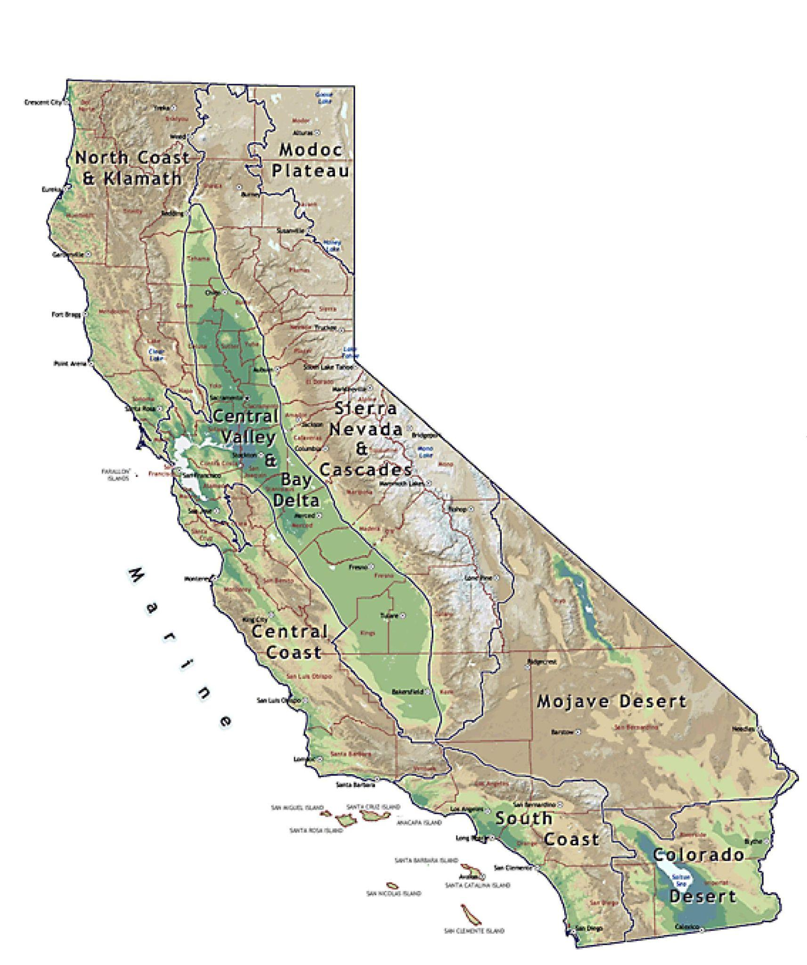
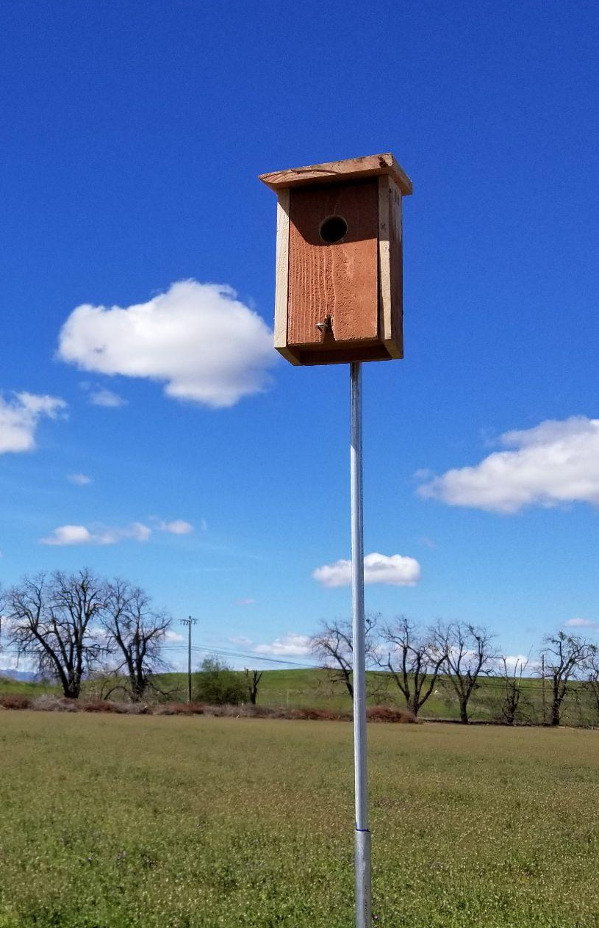
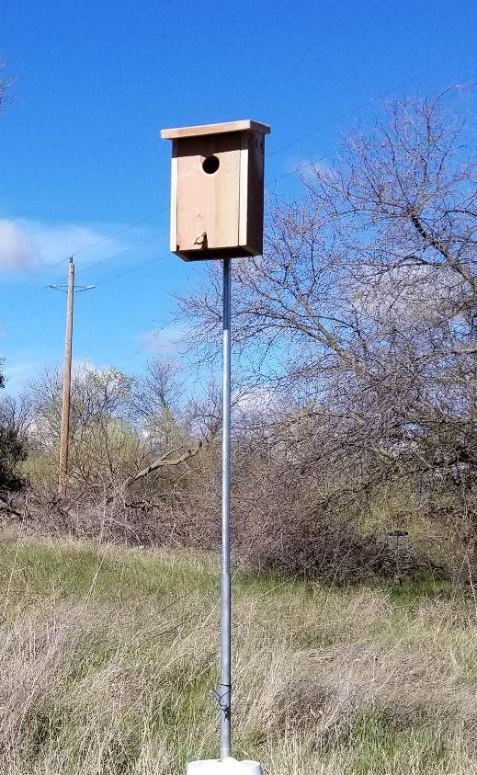
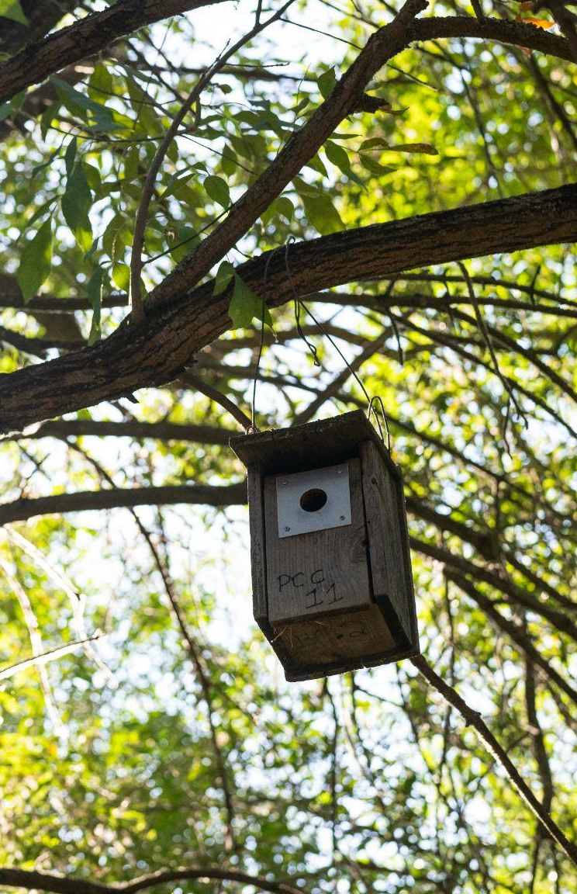
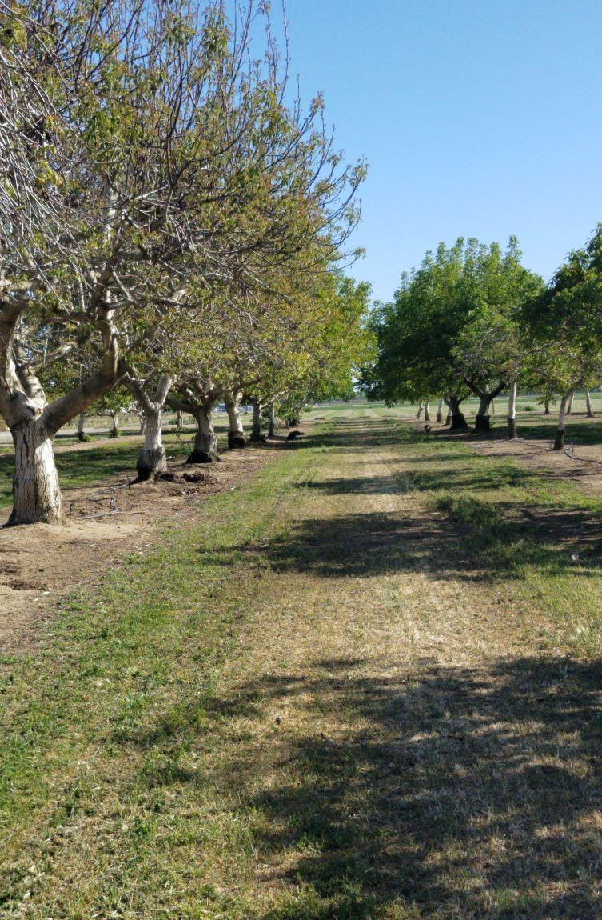
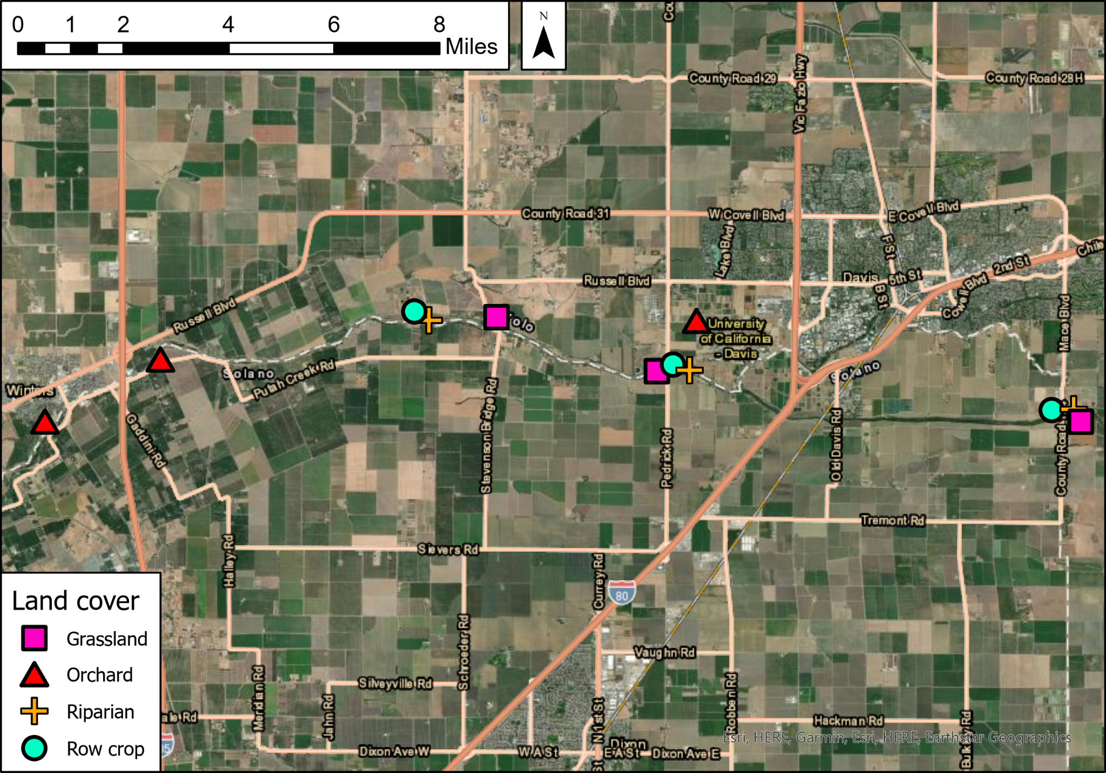
Forest
Davis, CA
Winters, CA
Putah Creek
Notes:
Collaborated with the MWFB here at UC Davis to set up 12 semi-clustered sites, three of each of four land uses, for a total of ~200 boxes, 50 of which we set up last spring, primarily in row crops. We monitor nests weekly, place temperature loggers in a subset of active nests (limited by logger availability and balanced across sites and land uses), and measured nestlings weekly. Each individual’s growth was tracked using nail polish. In addition, we placed motion-activated cameras on a subset of temperature-monitored nests to measure provisioning rate (N = 19 nests monitored at end of season).

